Slide 1

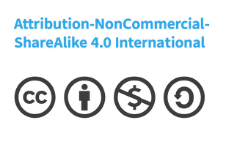




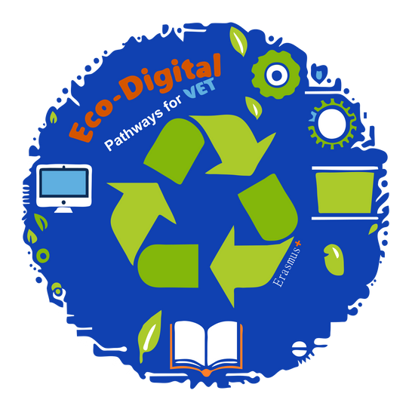



INVISIBLE electronic waste
team blue
The project “FACTS VET Force: Empowering VET Teachers and Students Against Disinformation” (2023-2-ES01-KA210-VET-000183017) is co-funded by the European Union. The views and opinions expressed in this publication are those of the author(s) only and do not necessarily reflect those of the European Union or the Spanish Service for the Internationalisation of Education (SEPIE). Neither the European Union nor the National Agency SEPIE can be held responsible for them.

Slide 2





List of Contents
What Is Invisible Electronic Waste?
Why This Problem Matters
Rethinking Electronic Waste
Sustainability & Impact
Applicability

Slide 3


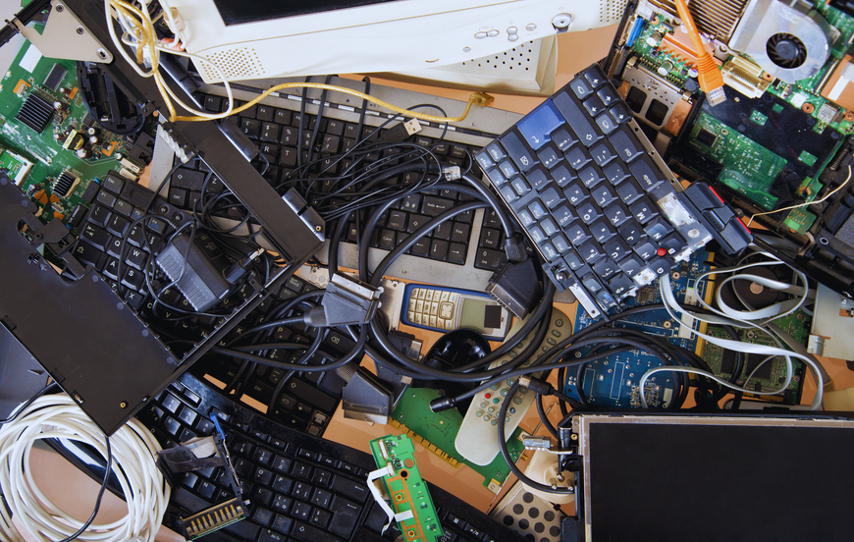


What Is Invisible Electronic Waste?
Invisible electronic waste is the type of e-waste we don’t notice — cables, chargers, old phones, broken keyboards, and spare electronic parts. These items often hide in drawers, classrooms, storage rooms, and offices. Even if they seem small, they create a big environmental impact

Slide 4
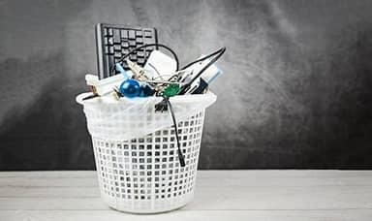

Why This Problem Matters?
These items contain harmful substances like lead and mercury, which can damage the environment if not handled correctly. At the same time, they contain valuable metals that can be reused. Schools and companies often replace devices regularly, but many items never get recycled. Solving this helps protect our planet and improves digital responsibility
Expanded details
* Toxic chemicals from electronics
* Loss of valuable materials
* Poor recycling habits in schools
* Lack of awareness

Slide 5


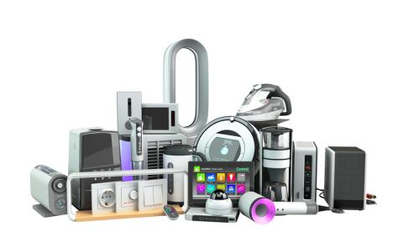
Modular Tech Library
Create a shared library of reusable electronic parts—screens, keyboards, RAM, chargers, cables, sensors and small components. Students and staff can borrow parts to repair devices instead of buying new ones. The library uses a simple barcode system to track components. This promotes creativity because students can experiment with combining old parts to build new devices or prototypes. It also encourages engineering thinking, reduces waste and makes technology more accessible to everyone.

Slide 6


Modular Tech Library
This promotes creativity because students can experiment with combining old parts to build new devices or prototypes. It also encourages engineering thinking, reduces waste and makes technology more accessible to everyone.

Slide 7


E-Waste Story Labels
Place QR-code labels on broken or discarded devices. When scanned, they show the device’s “story”: age, materials used, repair attempts, possible spare parts and recycling instructions. This turns invisible waste into visible knowledge. Students can even contribute by updating the device’s story after repairs. The idea transforms e-waste into an educational tool and encourages people to think about what happens after a device’s life ends.

Slide 8

Create small student teams trained to guide others in sustainable technology use. Their tasks include teaching classmates how to repair simple issues, organising collection drives, and helping teachers maintain devices. These ambassadors turn knowledge into action and make sustainability a permanent part of school culture. The idea is innovative because it blends peer education, leadership and practical repair skills while improving digital responsibility.
Green Tech Ambassador Teams

Slide 9



Sustainability & Impact: Why These Ideas Matter
These solutions reduce the environmental footprint of schools and companies by extending device lifespan, reducing the need for new purchases and preventing harmful materials from reaching landfills. Impact can be measured through:
* Number of devices repaired
* Kilograms of e-waste collected
* Money saved by reusing parts
* Number of students trained in repair skills
When combined, these actions significantly lower pollution and encourage a long-term circular economy mindset.

Slide 10



High-Impact Example: “Repair & Reuse Marathon Week”
  Organise a yearly event where students and staff bring old devices to be repaired or dismantled responsibly. Workshops include battery replacement, screen repair, safe soldering, and component recovery.
At the end, the community sees clear results: how many devices were fixed, how many parts were saved, and how much waste was avoided. This event leaves a strong environmental and educational impact and motivates continued sustainability behaviour.

Slide 11


Feasibility: Why These Ideas Are Realistic
These projects require minimal budget and can be done with existing resources: old devices, basic tools, unused parts and voluntary participation from IT students or technicians. They do not require advanced technology or external funding. Schools already replace devices regularly, meaning a steady supply of parts exists. Teachers from IT, electronics, environmental education or VET workshops can easily supervise activities. Feasibility is high because the solutions fit into existing structures and classes.

Slide 12
Applicability
Implementation is simple and flexible:
* Start with one room as the repair lab
* Use existing computers and broken devices for training
* Assign student ambassadors or VET trainees to manage tasks
* Collaborate with local recycling centres
* Track progress monthly
These solutions can be integrated into ICT, electronics, sustainability or vocational courses. Companies can use them in employee training or CSR programs. The approach is adaptable, scalable and suitable for many different institutions.

Slide 13



Conclusion: Innovation + Sustainability = Real Change
Reducing e-waste is not only about recycling — it’s about rethinking how we use technology. Innovative ideas help us see new possibilities, sustainability ensures long-term environmental benefits, feasibility makes projects realistic, and applicability ensures they can be adopted quickly. With commitment and teamwork, schools and VET companies can lead the way in reducing invisible electronic waste and shaping a greener digital future.

Slide 14

Thanks for your attention and have a nice day!

